Slide 1


Migrate. Innovate. Enable
Unlock the full power of Azure
Company Profile
Website: www.snp.com
Contact Email: sales@snp.com

Slide 2

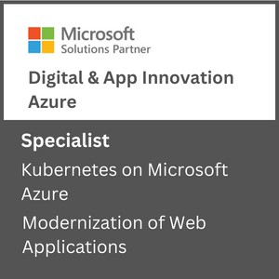
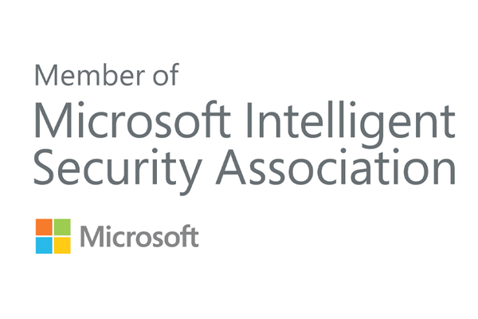
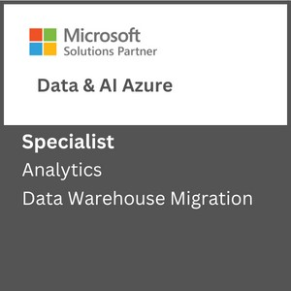
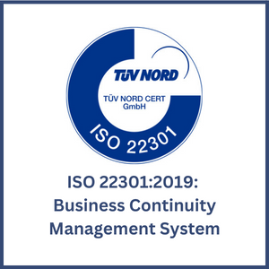
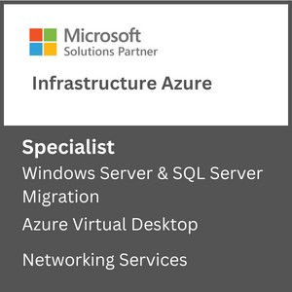
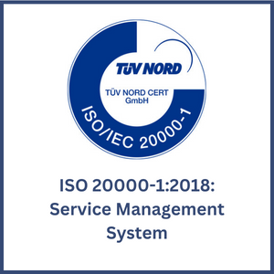

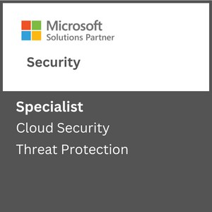
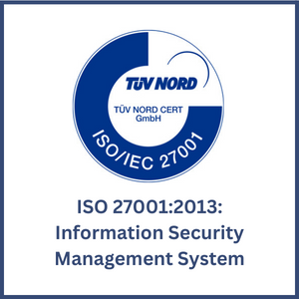

About SNP
Driving Innovation & Business Excellence with Microsoft Azure in:
SNP transforms businesses with innovative, cloud-based solutions that harness the power of Microsoft Azure. We are 100% Azure focused, 100% SMC focused and 100% certified for different Microsoft funding programs like ECIF, Azure Innovate and AMM.
SECURITY
Defend Against Threats with SIEM Plus XDR
Secure Multi Cloud Environments
Secure Identities and Access
Protect and Govern Sensitive Data
Mitigate Compliance and Privacy Risks
DevSec Ops
MICROSOFT ADVANCED
SPECIALIZATIONS
APPS & INFRASTRUCTURE
Migrate and Modernize Your Infrastructure and Workloads - WS/SQL on Azure; Linux/OSS DB on Azure; AVS; AVD
Protect Your Data and Ensure Business Resiliency with BCDR- Azure Backup, Azure Site Recovery, BCDR Solutions
ANALYTICS ON MICROSOFT AZURE
NETWORKING SERVICES
AZURE VIRTUAL DESKTOPS
KUBERNETES ON MICROSOFT AZURE
Migrate enterprise apps to Microsoft azure
INFRA & DATABASE MIGRATION TO MICROSOFT AZURE
CLOUD SECURITY
THREAT PROTECTION
DATA WAREHOUSE MIGRATION
Modernize Your Workloads with Azure at any Scale with HPC plus AI- Azure specialized VMs, Azure Cycle/Batch, Storage Services, Networking Services.
Innovate Across Hybrid and Edge with Azure Arc- Azure Arc, Arc-enabled data and ML, AKS, Microsoft Defender, Azure Monitor ,Azure Stack HCI
ISO Certifications:
DevOps on Azure: DevOps Maturity Model, CI/CD, IaaC, DevSecOps
DATA, ANALYTICS & AI
Innovate with AI and Cloud Scale Databases in Every App- Azure Cognitive Services, Azure Applied AI Services, Azure Cosmos DB, Azure MySQL & PostgreSQL, Azure SQL DB, Azure ML
Migrate and Modernize Your Data Estate- Azure SQL MI, Azure SQL IaaS, Azure Arc Data, Azure Cosmos DB, Azure PostgreSQL​, Azure MySQL
MICROSOFT PARTNER AWARDS
Power Business Decisions with Cloud Scale Analytics- Azure Synapse, Azure ML, Azure Databricks & PBI
Enable Unified Data Governance- With Microsoft Purview get unified data governance across on-premises, multi-cloud, and SaaS environments
DIGITAL & APPLICATION INNOVATION
2023 PARTNER OF THE YEAR
FINALIST
Security
Modernize Enterprise Applications- Azure App Service , Azure Spring Cloud, API Management, Logic Apps, Power Apps, AKS
Innovate and Scale with Cloud Native Apps - AKS, Azure Functions, Azure Container Apps, Azure DB for PostgreSQL, Azure Cosmos DB, Azure Arc
2021 MSUS PARTNER OF THE YEAR WINNER
Business Excellence in Solution Assessments
Enable Developer Productivity and Accelerate Delivery- Power Apps, Power Automate
Accelerate Innovation with Low Code- GitHub, Visual Studio
AZURE MANAGED SERVICES
2019 MSUS PARTNER OF THE YEAR WINNER
Intelligent Cloud & OSS on Azure
Support Desk Operations
Managed Azure Infrastructure Operations
Managed Security Operations
Managed App Services and Kubernetes.
Optimization Services
Managed DR & Backup Operations
Managed Data Operations
Managed DevOps Services
2019 PARTNER OF THE YEAR FINALIST
Open-Source Applications & Infrastructure on Azure
CSP SERVICES
Licensing Support
Azure Billing Support
Azure Service Health Support
FinOps as an Add on Support

Slide 3
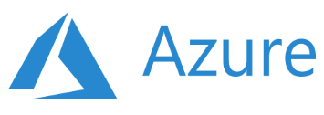
Key Focus Areas
Recent Projects
Artificial Intelligence & Machine Learning
Data Engineering Services
Database Modernization
MLOps
Solution Architecture & Consulting Services
Business Intelligence & Visualization Services
Power Bi with Synapse Analytics
Data Platform in 30 Days
Data Integration Services
Enterprise DW Modernization
Data Integration Services
ML Model Building & Consulting
ML Platform Operationalization (MLOps)
SQL Server Modernization with Azure PaaS
Power BI Governance
Power BI Development
Data, AI & Analytics
Migrate and transform data for data driven customers using solutions such as data engineering, BI and AI
Apps & Infrastructure
Hybrid Cloud
Hybrid Security Rationalization & Strategy
Cloud Infrastructure & Management
Hybrid Cloud Strategy with Azure Arc
App Innovation
DevOps & GitOps Solutions
Open-Source Solutions
Hybrid Identity
API Management
Infrastructure Rationalization & Migration Roadmap design
Servers Lift & Shift
OSS & SQL Migration to PaaS
Citrix Virtual Desktops
Windows Virtual Desktops
Hybrid Cloud Framework
Hybrid Management with Azure Arc
Compliance Policy as a Code
Hybrid Security Rationalization
.NET – Application Modernization with Azure PaaS
OSS - Application Modernization with Containers & Azure PaaS
AKS Maturity Model
Kubernetes & Containers
Red Hat Cloud Solutions
DR & Cloud Failover
Azure Sentinel & SIEM Integration
Azure Sentinel - Workflow & Connectors development
End-to-end cloud solutions which include infrastructure and operations, DevOps and automation and application modernization
Azure Managed Services
CSP Hosting Services
Support Desk Operations
Managed Azure Infrastructure Operations
Managed Disaster Recovery & Backup Operations
Virtual Desktop Infrastructure –(VDI) Operations
Managed Data Platform Operations
Managed DevOps Services
Managed Security Operations
Managed VDI Operations (Citrix & Windows VDI)
Premium Managed Services
Azure Managed Services supporting the full Microsoft Azure solution suite including infrastructure, data, security, DevOps and more
Industries We Serve
Healthcare
Biotech
Financial Services
Manufacturing
Professional Services
Engineering & Architecture

Slide 4
Virtual Network Gateway
KONYALA DATHA SAI CHANDU​

Slide 5
AGENDA
Virtual Network Gateway.
Point to Site connection.
Site to Site connection.
Types of VPN connection Protocols.
Types of Authentication Protocols.
IGP (Interior Gateway Protocol and BGP (Border Gateway Protocol).
Autonomous Systems.
Path Vector Protocol.
5

Slide 6

1. Virtual Network Gateway
Azure VPN Gateway is a service that uses a specific type of virtual network gateway.
One of the settings that you specify when creating a virtual network gateway is the "gateway type".
It will send encrypted traffic between an Azure virtual network and on-premises locations over the public Internet.
You can also use VPN Gateway to send encrypted traffic between Azure virtual networks over the Microsoft network.
Multiple connections can be created to the same VPN gateway. When you create multiple connections, all VPN tunnels share the available gateway bandwidth.
Virtual Network Gateway
Notes:
- gateway types

Slide 7
2 - Point to Site VPN connection
A point-to-site (P2S) VPN gateway connection lets you create a secure connection to your virtual network from an individual client computer.
A P2S connection is established by starting it from the client computer.
This solution is useful for telecommuters who want to connect to Azure VNets from a remote location, such as from home or a conference.
P2S connections don't require an on-premises public-facing IP address or a VPN device.
P2S connections can be used with S2S connections through the same VPN gateway, as long as all the configuration requirements for both connections are compatible.

Slide 8
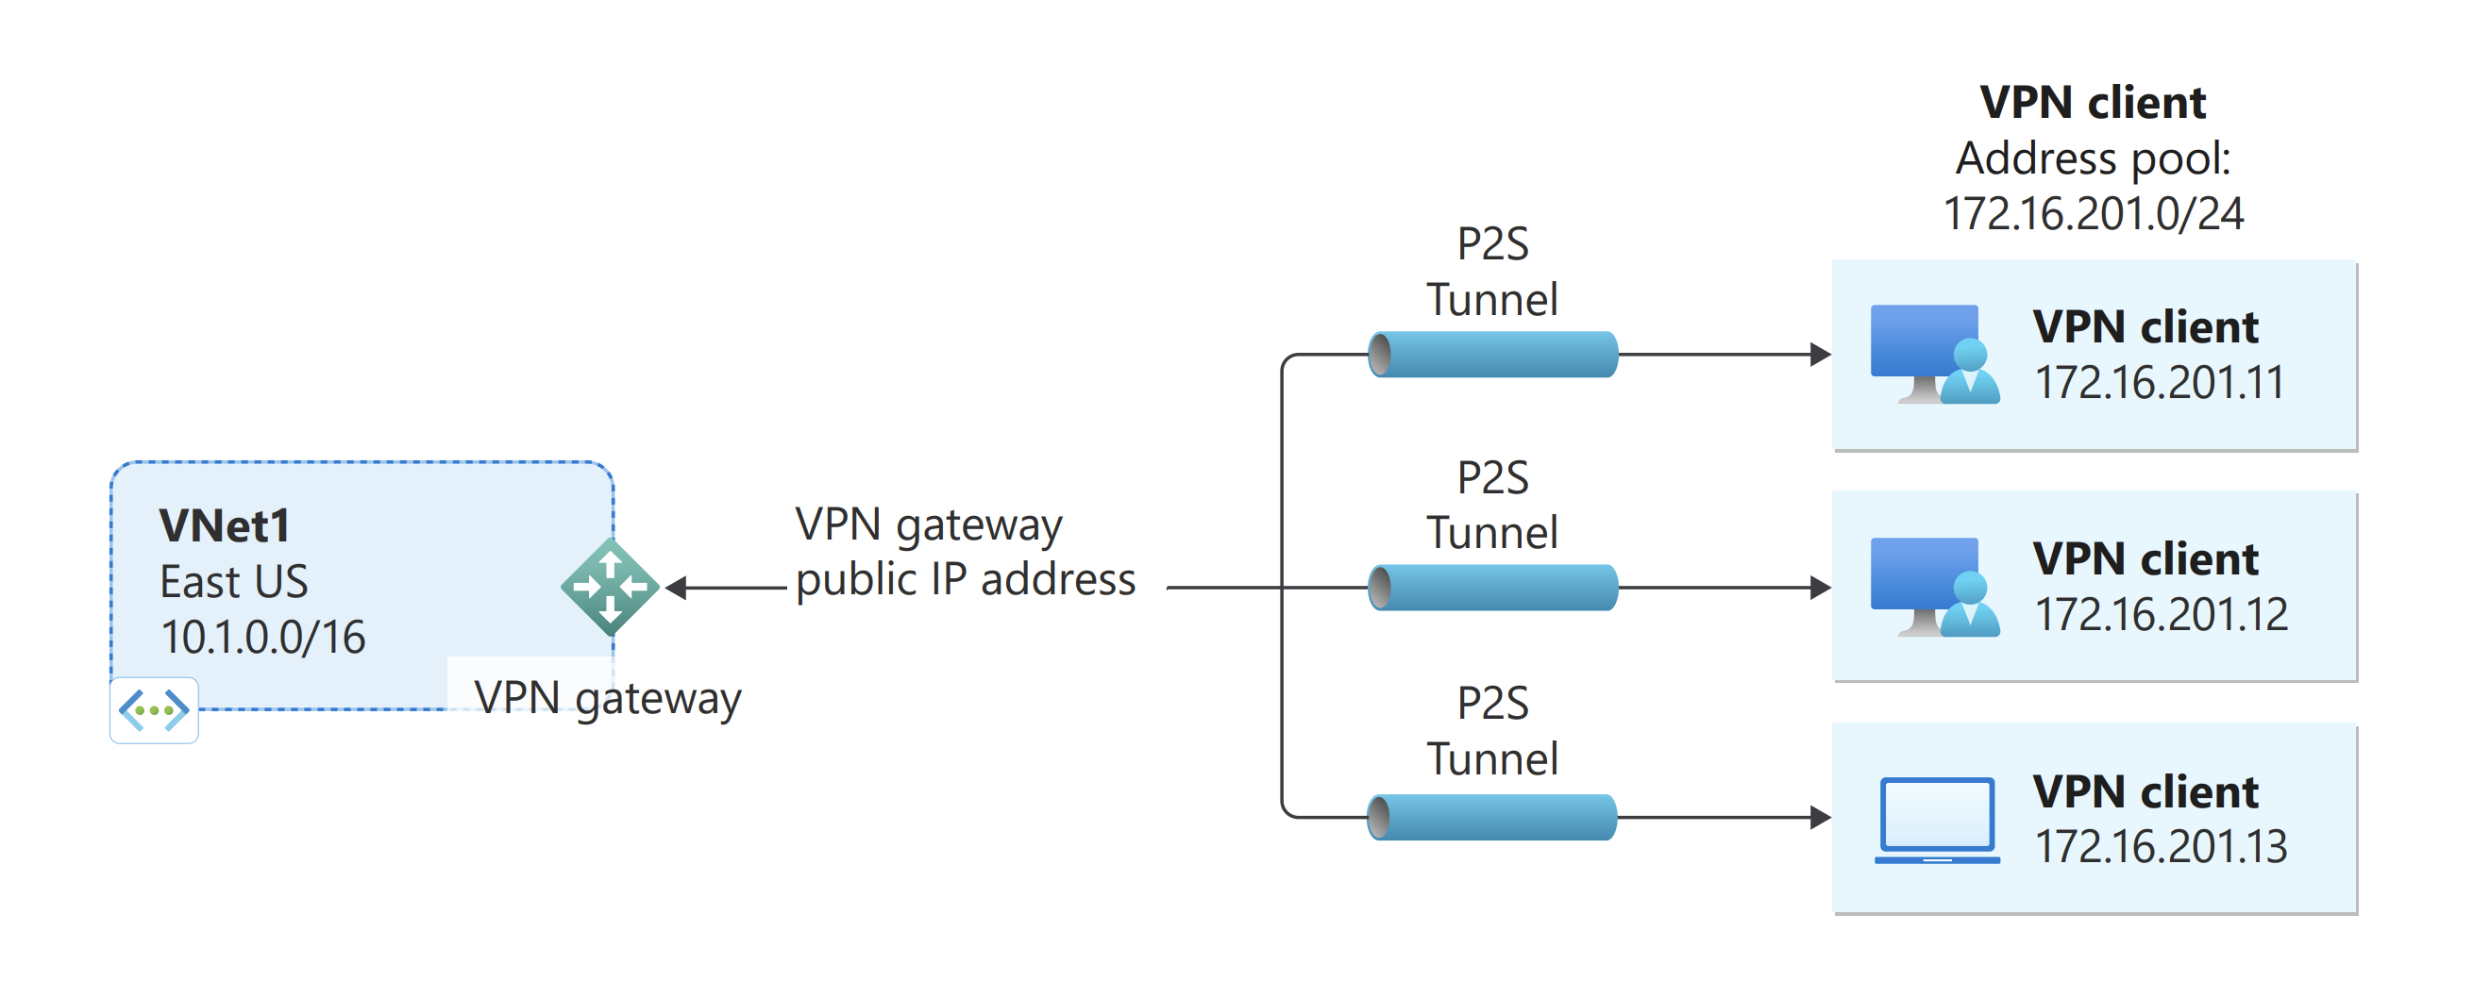
Point to Point VPN connection

Slide 9
3 - Site to Site VPN connection
A Site-to-site (S2S) VPN gateway connection is a connection over IPsec/IKE (IKEv1 or IKEv2) VPN tunnel.
A S2S connection requires a VPN device located on-premises that has a public IP address assigned to it.
S2S connections can be used for cross-premises configurations.
A cross-premises VPN connection consists of an Azure VPN gateway, an on-premises VPN device, and an IPsec S2S VPN tunnel connecting the two.
VPN Gateway can be configured in active-standby mode using one public IP or in active-active mode using two public IPs.

Slide 10
3.1 – Active – Standby
one IPsec tunnel is active and the other tunnel is in standby.
In this setup, traffic flows through the active tunnel, and if some issue happens with this tunnel, the traffic switches over to the standby tunnel.
3.2 – Active – Active
Setting up VPN Gateway in active-active mode is recommended as
Both the IPsec tunnels are simultaneously active, with data flowing through both tunnels at the same time.
The switch over will cause a brief interruption.
For planned maintenance, the connectivity should be restored within 10 to 15 seconds.
For unplanned issues, the connection recovery will be longer, about 1 to 3 minutes.
P2S connections will be disconnected and the users will need to reconnect from the client machines.

Slide 11
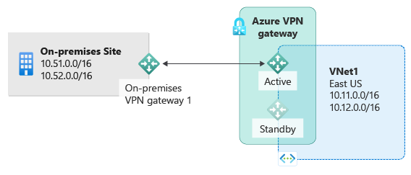

Slide 12
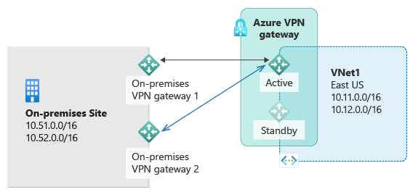
To provide better availability for your cross premises connections, there are a few options available:
Multiple on-premises VPN devices
Active-active Azure VPN gateway
Combination of both
Multiple on-premises VPN devices

Slide 13
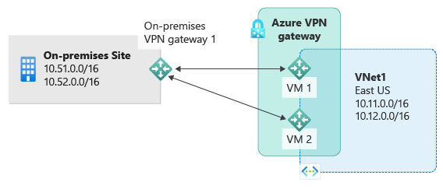
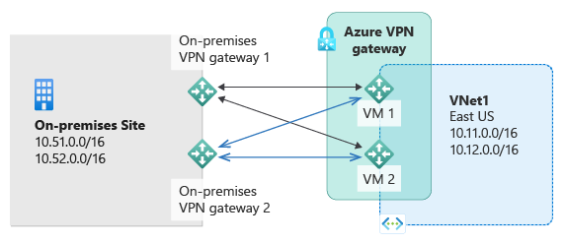
Active-active VPN gateways
active-active VPN gateways for both Azure and on-premises

Slide 14
4 – Connection Protocols
Point-to-site VPN can use one of the following protocols:
Secure Socket Tunneling Protocol (SSTP).
OpenVPN Protocol.
IKEv2 VPN
SSTP
VPN protocol developed by Microsoft that allows you to create a secure connection to a VPN server over the internet.
SSTP is mainly designed for Windows devices, but it can also work on Linux and macOS with some configuration.
SSTP uses the deprecated SSL 3.0 protocol which is vulnerable to the POODLE bug.

Slide 15
OpenVPN
OpenVPN is an open-source VPN protocol that offers a high level of security and performance.
It can also use different transport protocols, such as UDP or TCP, to optimize your VPN speed and reliability.
UDP is faster but less reliable, while TCP is slower but more reliable.
OpenVPN is compatible with Windows, Mac, Linux, Android, iOS, and more.
OpenVPN uses the TLS protocol which is generally more secure and is not affected by POODLE.
IKEv2
IKEv2 is a tunneling protocol within the IPSec protocol suite.
IKEv2 uses UDP as the transport layer protocol.
IKEv2 is often paired with IPSec, which is another protocol that provides additional security.
The combination of IKEv2 and IPSec is commonly known as IKEv2/IPSec.
Notes:
What is a POODLE Attack?
The POODLE (Padding Oracle on Downgraded Legacy Encryption) attack is a complex cyberattack whereby the attacker can eavesdrop on communication encrypted using SSL 3.0. The POODLE vulnerability is only present in the outdated Secure Sockets Layer (SSL) protocol. It is no longer present in the newer Transport Layer Security protocol (TLS). Since SSTP uses SSL and OpenVPN uses TLS, OpenVPN has a huge advantage over SSTP in terms of security.
Note: The POODLE attack was originally designed to exploit a vulnerability in the SSL 3.0 protocol, which is no longer present in the TLS protocol. However, a variant of the POODLE attack was discovered that can also affect some implementations of TLS, if they do not validate the encryption padding properly. This means that some servers may still be vulnerable to POODLE, even if they disable SSL and use TLS instead.
url - https://rublon.com/blog/sstp-openvpn-difference/#:~:text=What%20is%20a,use%20TLS%20instead.

Slide 16
5 – Types of Authentication Protocols
Before Azure accepts a P2S VPN connection, the user has to be authenticated first.
Certification Authentication.
Microsoft Entra authentication.
Radius Authentication.
Certificate Authentication
Self-signed root certificate is used to create client certificates.
The root certificate is uploaded to the Azure VPN gateway, establishing trust for the client certificates it issued.
The gateway verifies the client certificate's authenticity using the trusted root certificate.
If the certificate is valid and trusted, the gateway grants access to the virtual network or else, denied.

Slide 17
2. Microsoft Entra authentication
Allows users to connect to Azure using their Microsoft Entra credentials.
supported for OpenVPN protocol and also requires the use of the Azure VPN Client.
Following options are required for the authentication.
Issuer id
the VPN gateway trusts the tokens issued by the specified authority.
Format - https://sts.windows.net/{AzureADTenantID}/
Audience
Identifies the intended recipient of the security tokens.
Format – Application id or resource id
Tenant id
Links the VPN gateway to the correct Azure AD tenant for authentication.
Format - 8eaef023-2b34-4da1-9baa-8bc8c9d6a490.

Slide 18
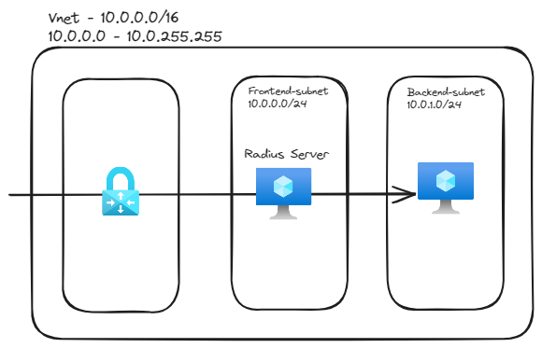
3. Radius Authentication
The RADIUS server can be deployed on-premises, or in the Azure VNet.
You can also configure two RADIUS servers for high availability.

Slide 19
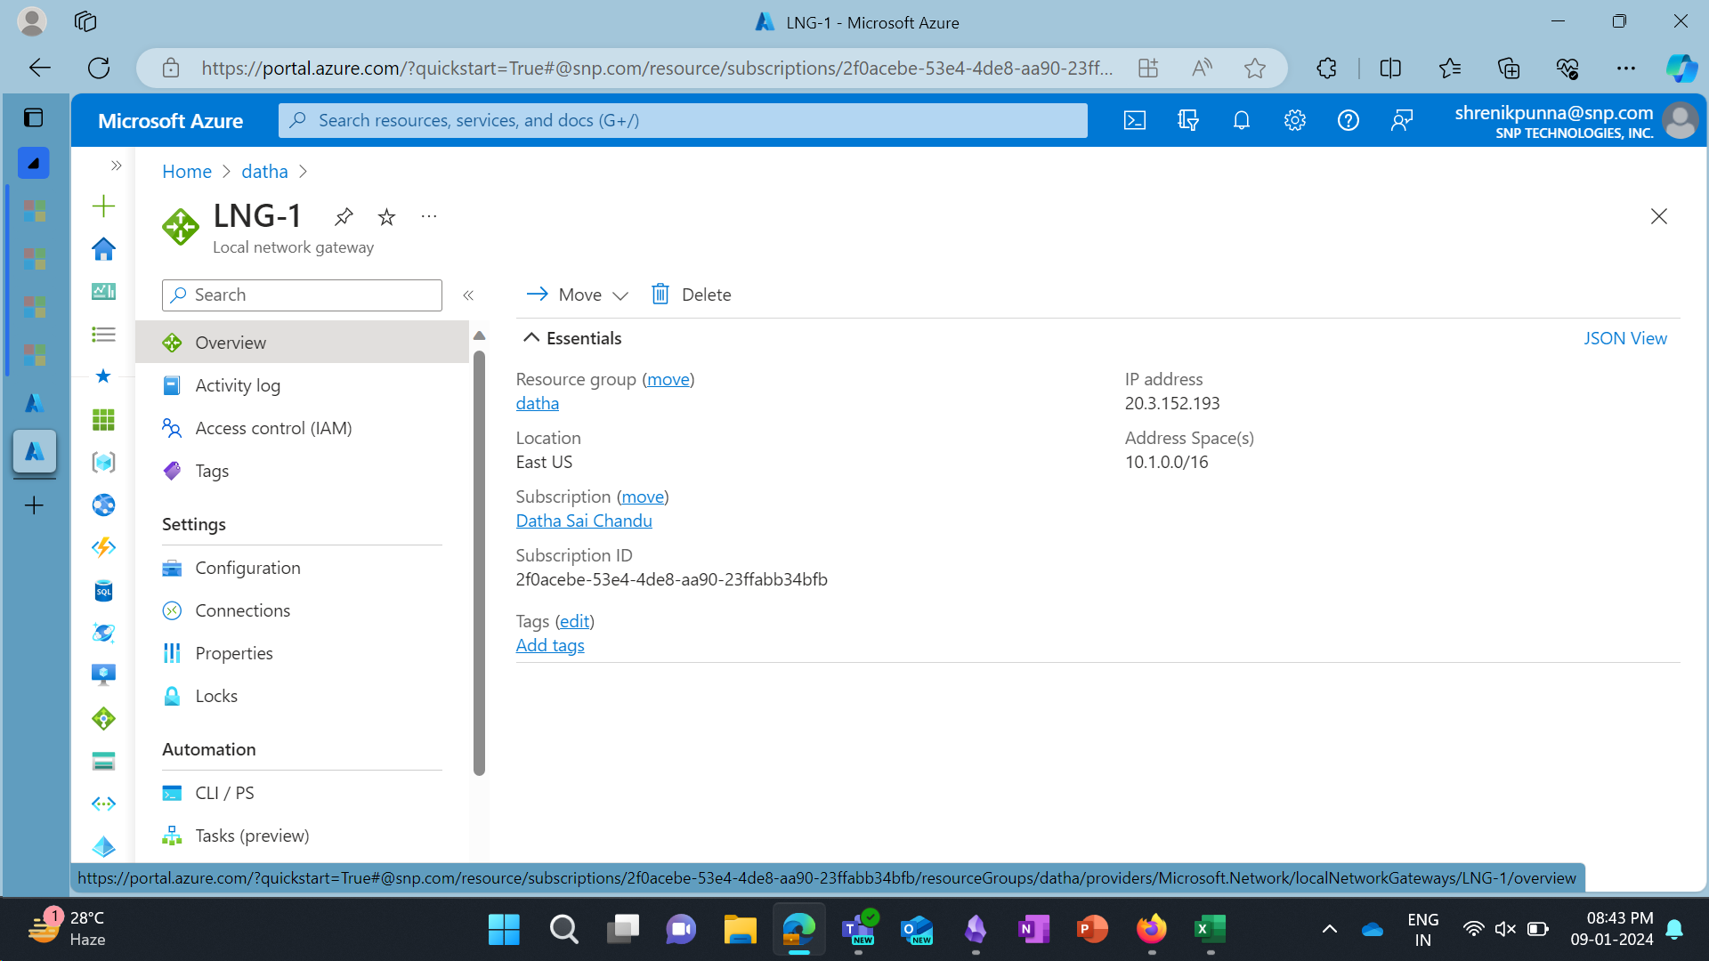
6 – Local Network Gateway
Local Network Gateways

Slide 20
7 – IGP and BGP
1. IGP (Interior Gateway Protocol)
Operates within a single Autonomous System (AS), which is a network under a single administrative control.
Focuses on finding the shortest path between routers within the AS.
2. BGP (Border Gateway Protocol)
Connects multiple Autonomous Systems on the internet.
Handles routing between, not within, AS.
Uses a path-vector approach, considering multiple factors like path length and network policies.
Also called as Path vector protocol

Slide 21
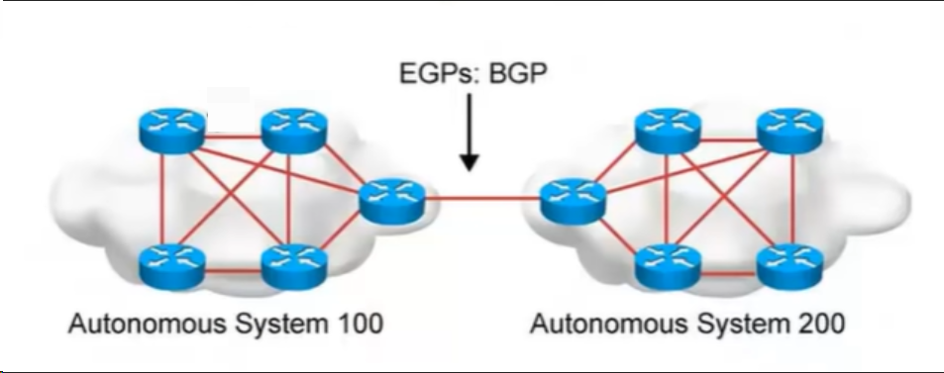
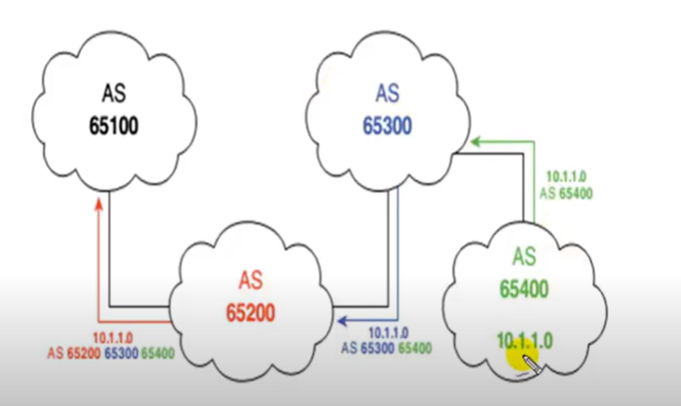
Autonomous Systems
An Autonomous Systems is a Collection of networks under a single technical administration
Exchange of loop-free routing information is guaranteed
Path Vector Protocol
method of sending the routes with path information.
To ensure that routing information does not circulate endlessly in the network.
BGP uses a few key mechanisms to prevent loops like AS Path Attribute

Slide 22
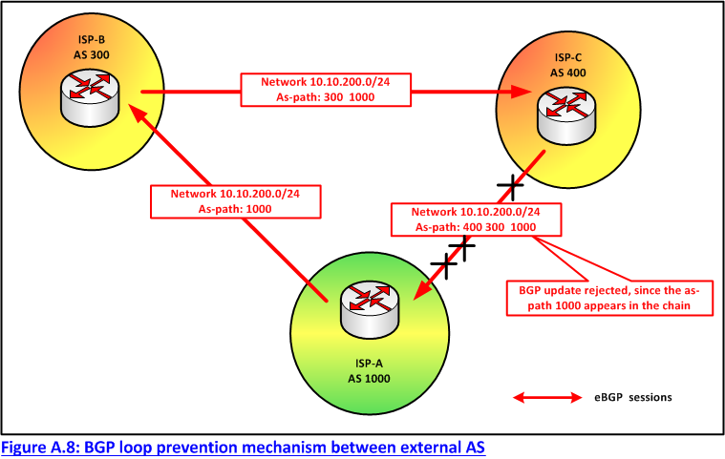
AS Path Attribute
The AS Path attribute is a list of AS numbers that a route has traversed to reach the current AS.
When a BGP router receives an update, It checks the AS Path to ensure that its own AS number is not present in the list.
If a router identifies its own Autonomous System (AS) number in the AS Path, it will reject the route to mitigate the risk of a routing loop.

Slide 23

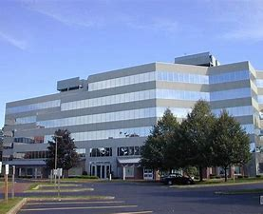

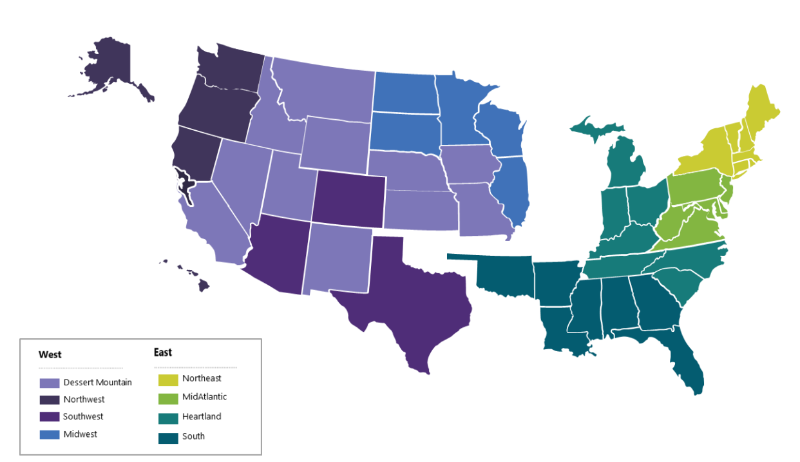

Contact Us:
Company Headquarters
SNP Technologies, 2319 Whitney Avenue, Suite 3C Hamden, CT 06518-3535,
(203) 287-9114
Sachin Parikh
VP of Business Development
sachin@snp.com
203-287-9114 X 112
Phil Balogh
Director Sales- North -USA
phil@snp.com
203-228-0310
Emerging/Investment
Market
Established
Market
Michael Fiorito
Director Sales- South- USA
Michael.fiorito@snp.com
917-753-0346
100% focused in SMC

Slide 24
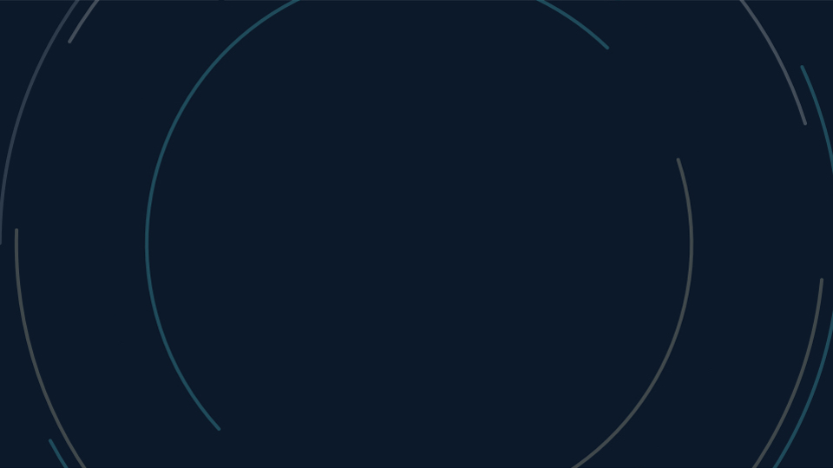

www.snp.com
2319 Whitney Ave. | Suite 3C | Hamden, CT 06518

